Slide 1
Identifying Fingerspelling Images Using TensorFlow
Ayisat Akintoye, Jules Donaghey, Kathryn Hays, James Houston, Brian Nguyen

Slide 2
Fingerspelling & Sign Recognition Research
Communication in the 21st century is aided by technology
Fingerspelling (American Sign Language)
Convolutional neural network (CNN) and transfer learning
Notes:
Sign language is the formalized nonverbal communication utilized by deaf, hard of hearing, nonverbal, and abled people. Communication via sign language is often met with a language barrier that can be augmented using technology, like machine learning and artificial intelligence.

Slide 3
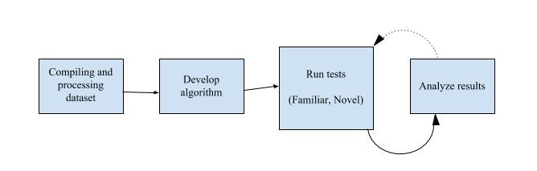
METHODS
Dataset: ASL FingerSpelling Dataset from the University of Surrey’s Center for Vision, Speech and Signal Processing
TensorFlow & TensorBoard
Notes:
This project sought to identify fingerspelling hand gestures based in American Sign Language (ASL) using a convolutional neural network. Variance in size, shape, and position of hands and fingers pose a potential difficulty in automated identification of signs; these errors were identified using a confusion matrix. Static and dynamic images were presented, as well as familiar and novel images.

Slide 4
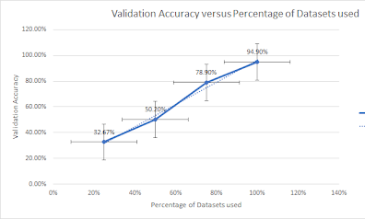
RESULTS
There was an average accuracy of 80% over time.
Increasing the values of the dataset in increments for training showed that higher accuracy was achieved with greater portions of the dataset.
Twofold cross validation yielded similar
results.
Notes:
There was an average accuracy value of 80% over time and increasing the values of the dataset for training led to greater accuracy results for the test data.

Slide 5
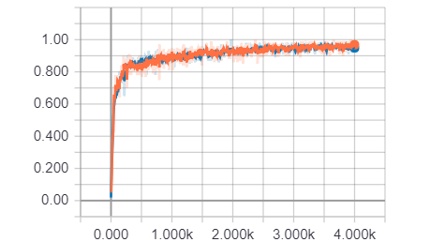
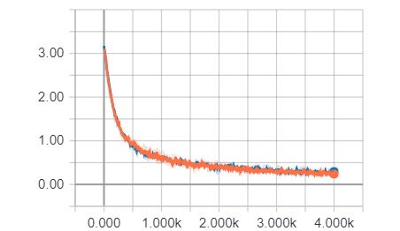
RESULTS
Tensorboard → Graphs and ‘histograms’
Accuracy and cross-entropy of training (orange) and test (blue)

Slide 6
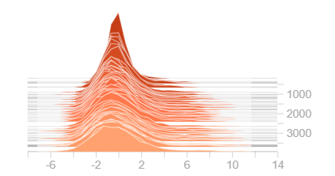
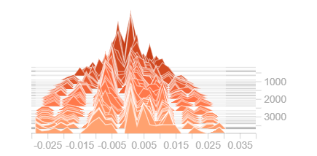
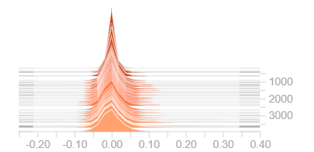
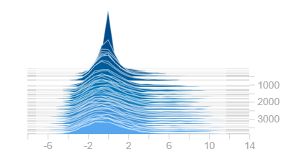
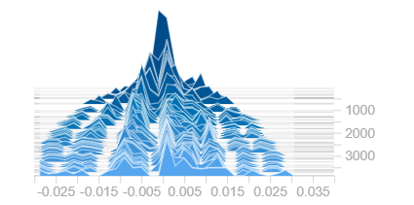
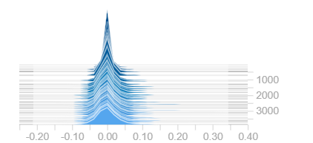
RESULTS
Training - Preactivation | Training - Biases | Training - Weights
Test - Preactivation | Test - Biases | Test - Weights

Slide 7
DISCUSSION
An important takeaway is the feasibility of our project as similar work serves as the baseline for more complex neural networks for ASL to text interpretation and other projects in the field.
Incorporation of gestures into user interfaces
Incorporation of latent semantics analysis to provide contextual narrowing of sign interpretation → “predictive text”
Notes:
summarize results, compare to related methods, implications, 1-2 pages

Slide 8
REFERENCES
Pugeault, N., & Bowden, R. (2011, November). Spelling it out: Real-time ASL fingerspelling recognition. In Computer Vision Workshops (ICCV Workshops), 2011 IEEE International Conference on (pp. 1114-1119). IEEE.
Image Recognition. TensorFlow. (n.d.). Retrieved September, 2018, from https://www.tensorflow.org/tutorials/images/image_recognition
Ameen, S., & Vadera, S. (2017). A convolutional neural network to classify American Sign Language fingerspelling from depth and colour images. Expert Systems, 34(3).
Chaudhary, B. (2017). Real-time translation of sign language into text. Data Science Retreat. https://github.com/BelalC/sign2text, apr.
Hinton, G. E., Osindero, S., & Teh, Y. W. (2006). A fast learning algorithm for deep belief nets. Neural computation, 18(7), 1527-1554.

